Slide 1
Tutorial
Edit Video
KINEMASTER APPLICATION

Slide 2
Crew Of Group
Arlan Ady Pratama (4)
Mochammad Syaifuddin Zuhri (17)
Sesha Dwi Lestari (27)

Slide 3

What Is
The App Kinemaster?

Slide 4
A mobile application that functions to edit videos, which includes simple features to be easily understood by users.
KINEMASTER

Slide 5
How To Edit Video
With The App Kinemaster?

Slide 6


1. First, Download app Kinemaster in the Google Play Store or App Store!
Google Play Store
App Store

Slide 7
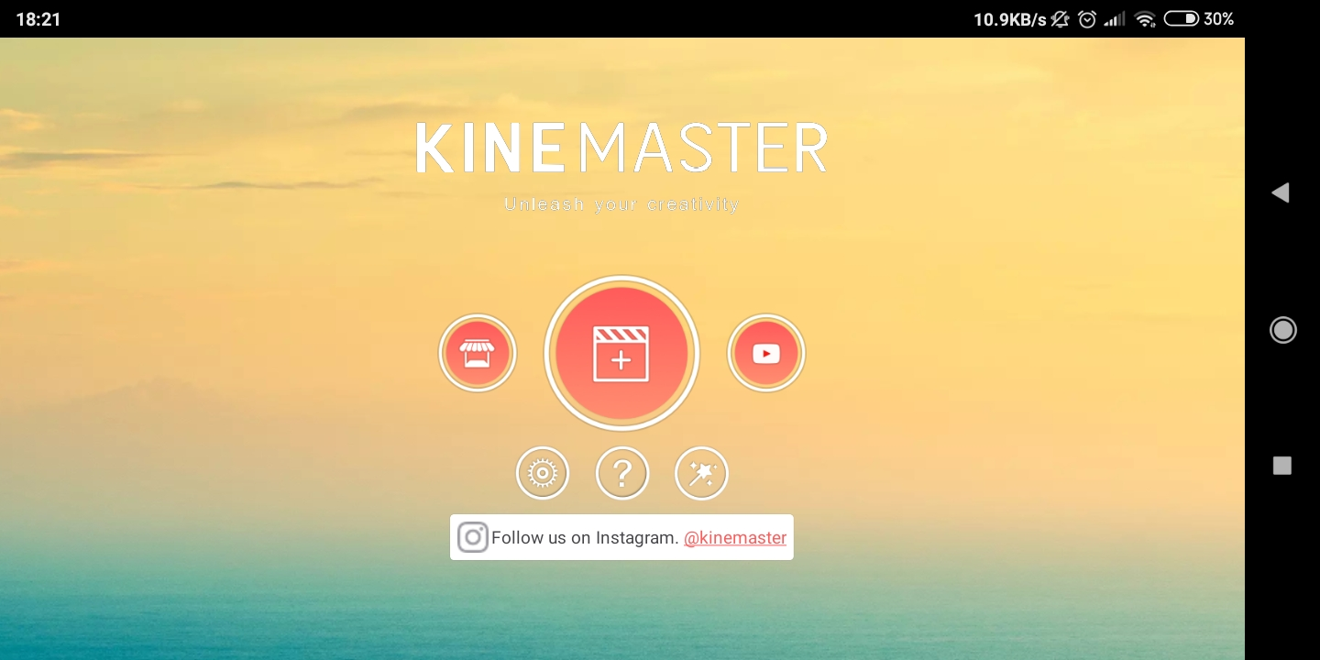
2. After download, open the app Kinemaster

Slide 8
3. After that, select the add button on the initial display kinemaster.

Slide 9
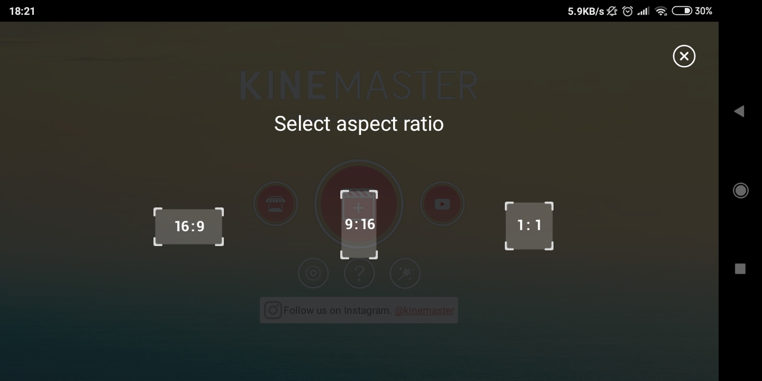
4. After that, select aspect ratio.

Slide 10
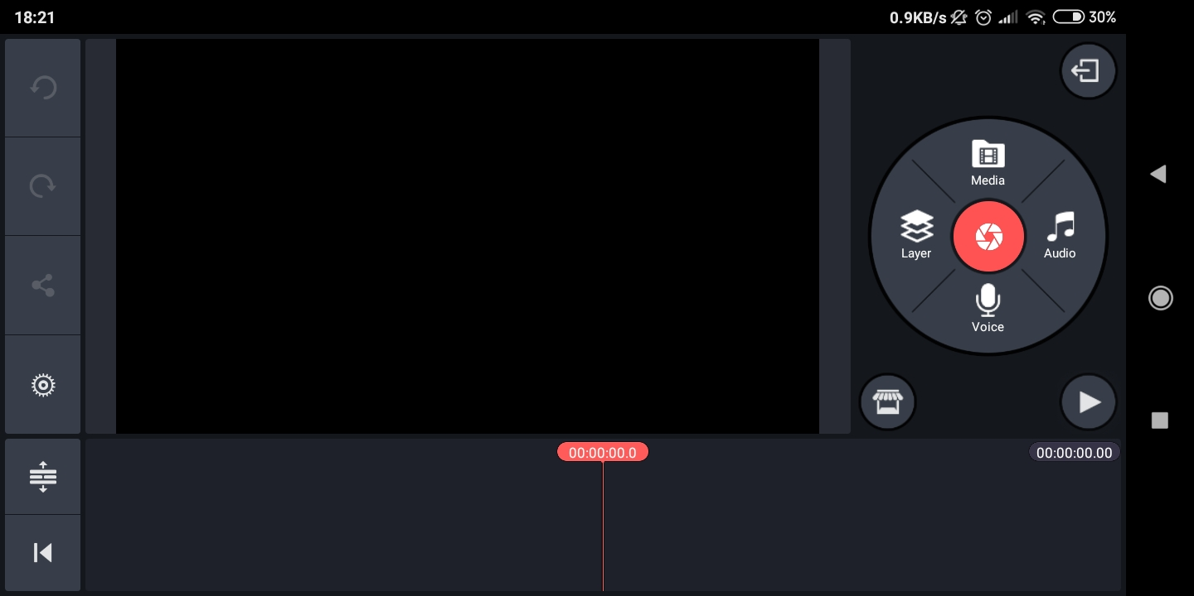
5. Next, enter a video to be edited.

Slide 11
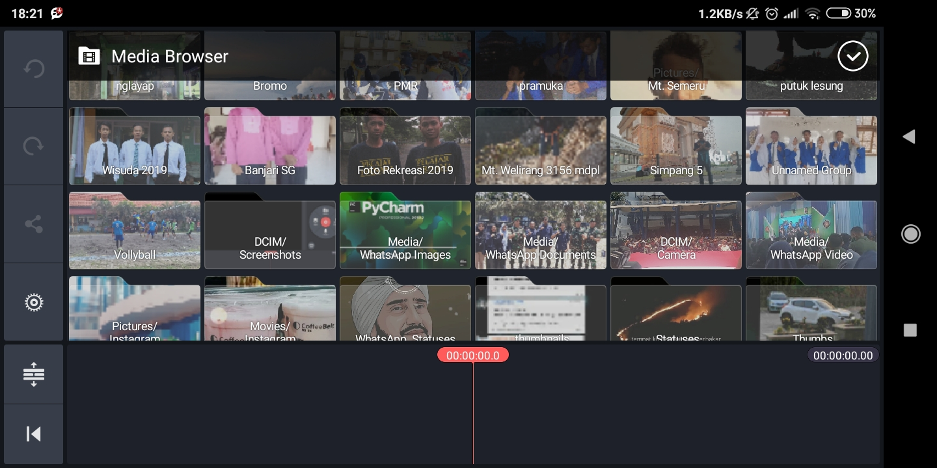
6. Next, find the video to be edited, then click the checkmark on the top right corner.

Slide 12
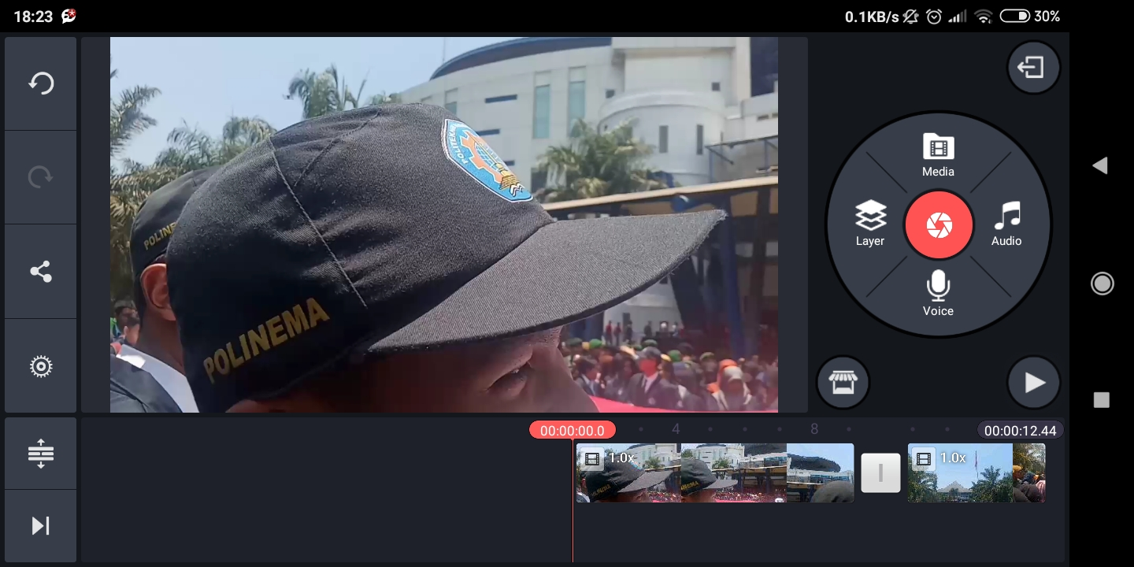
7. After that, will be heading to edit look like this.

Slide 13
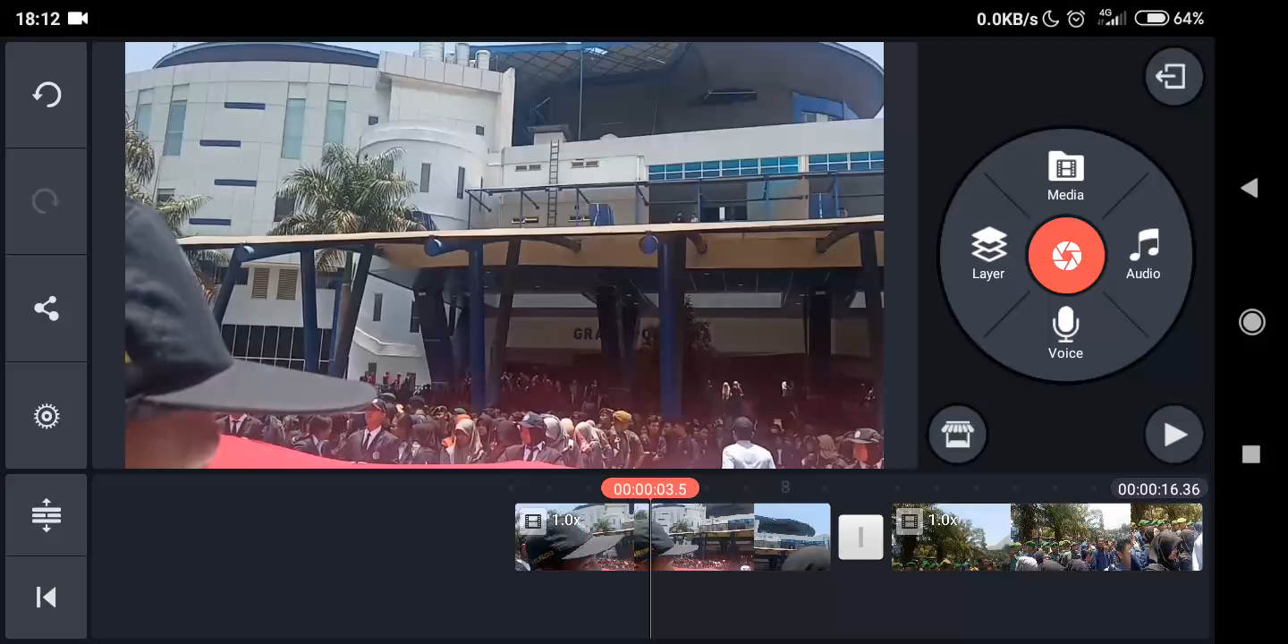
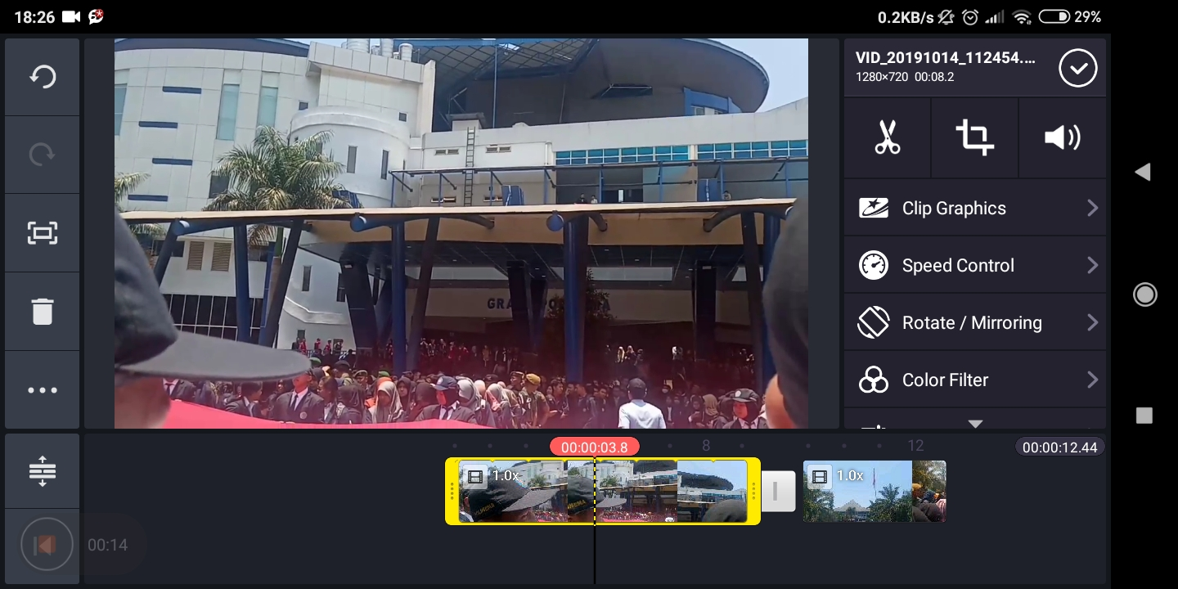
8. Next, cutting a video.

Slide 14
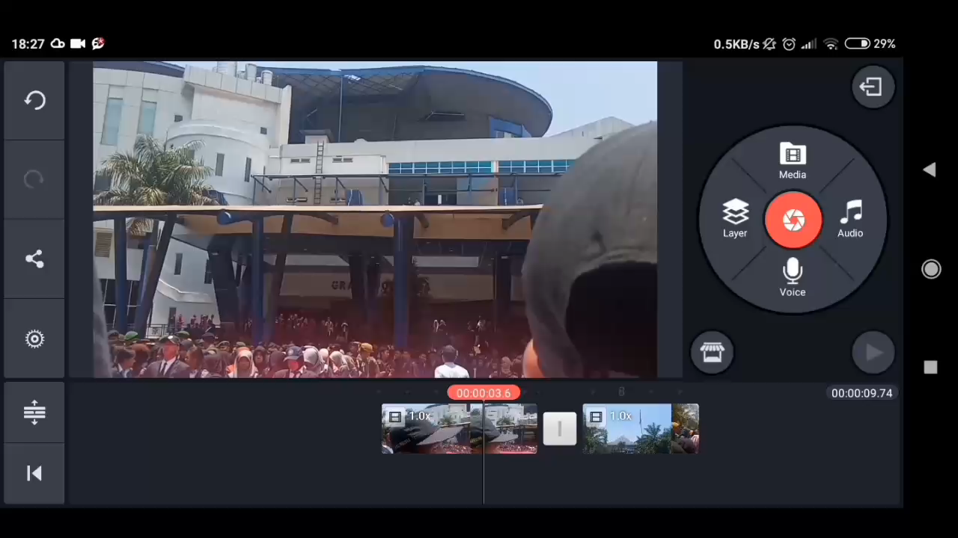
9. Then, Select the type of transition effect that you want to use between videos

Slide 15
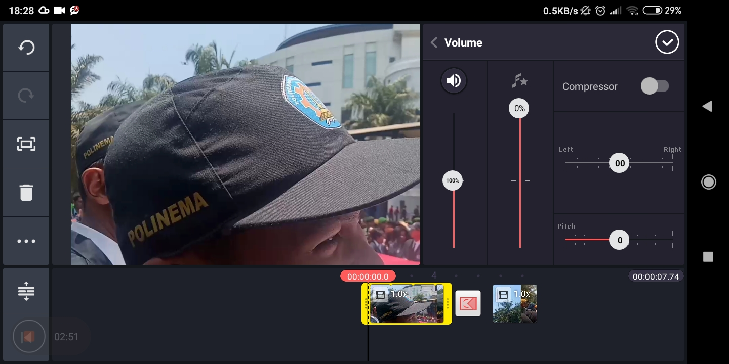
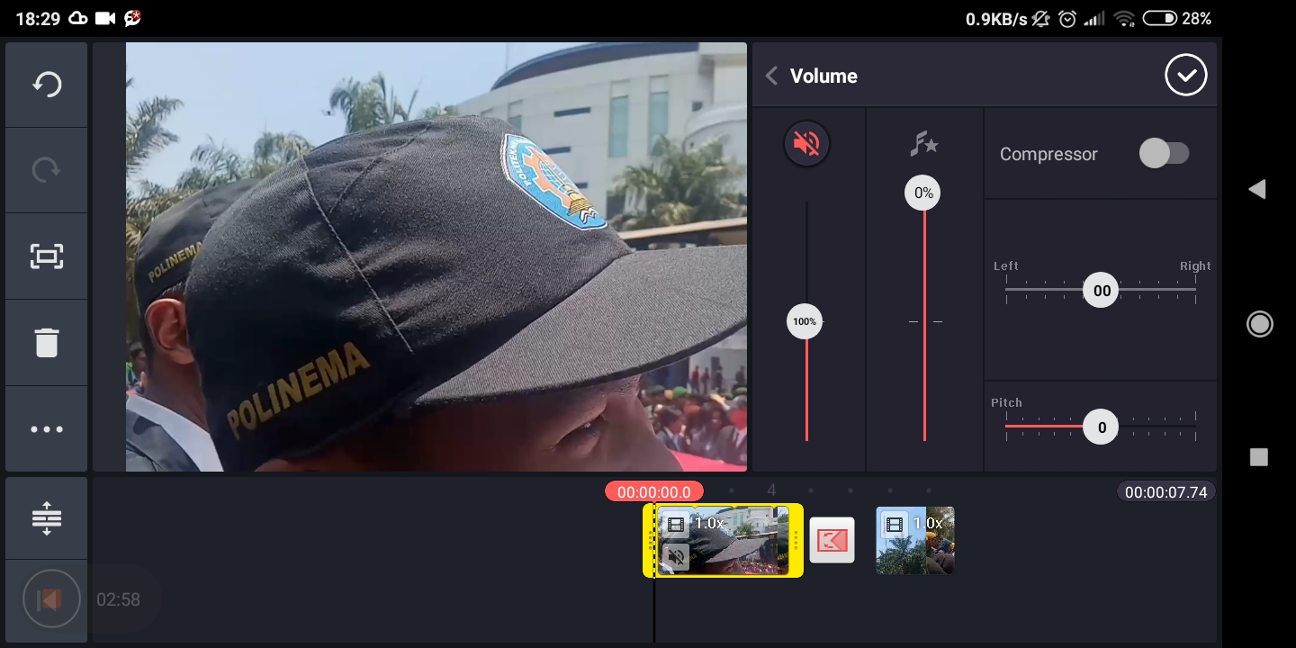
10. Next, adjust the volume on the video

Slide 16
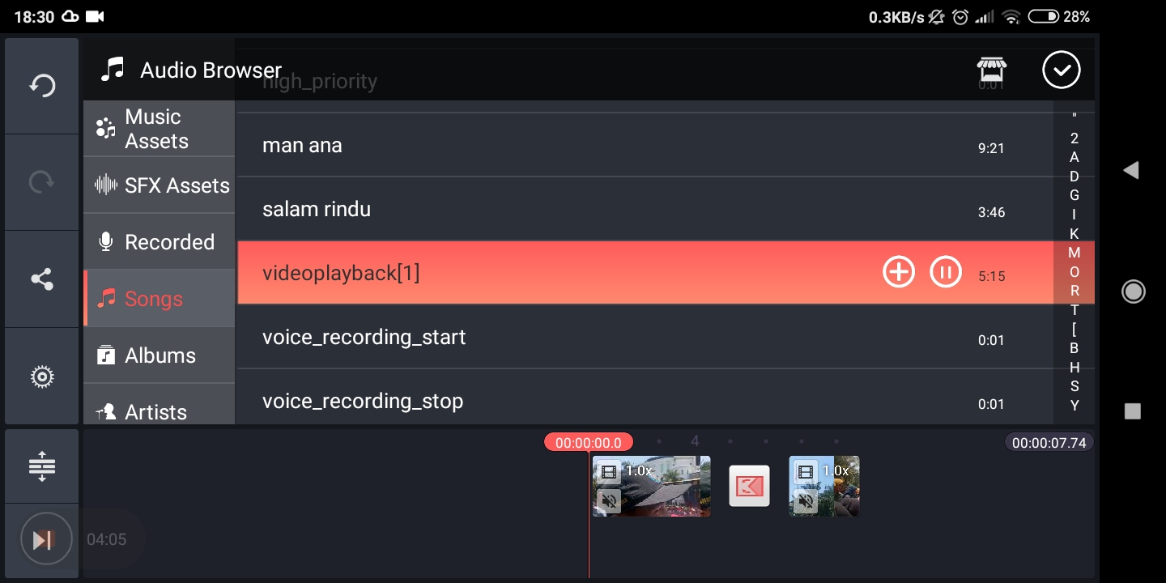
11. Next, add audio on the video.

Slide 17
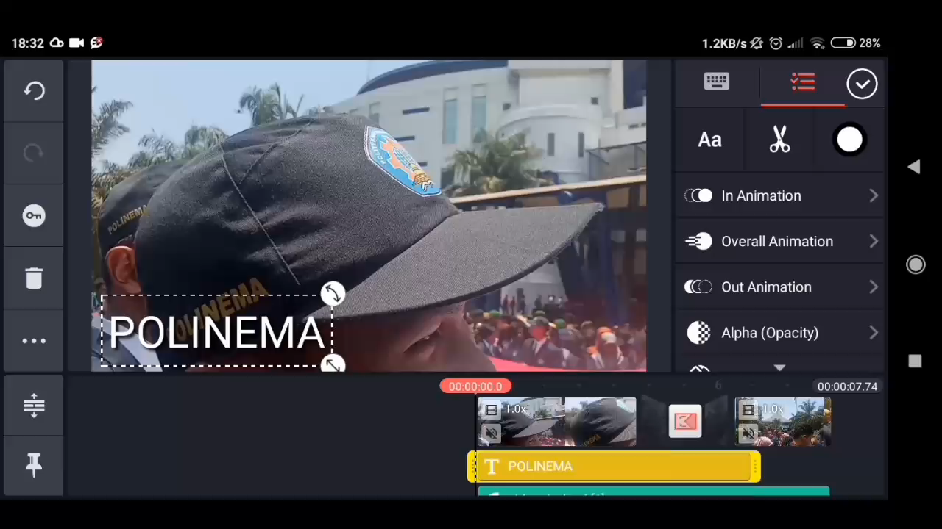
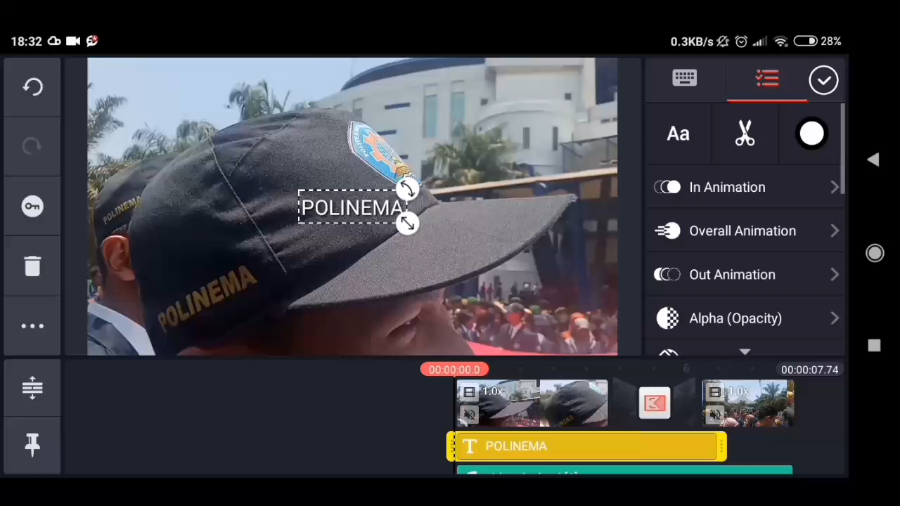
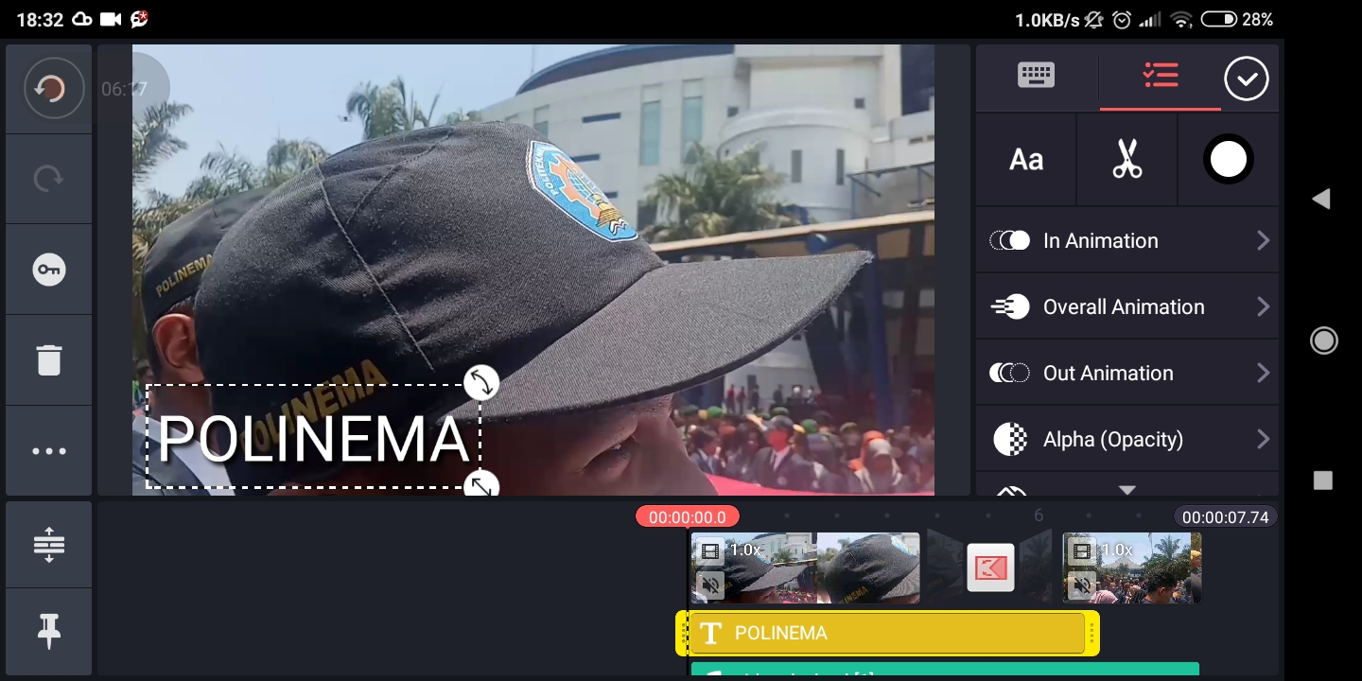
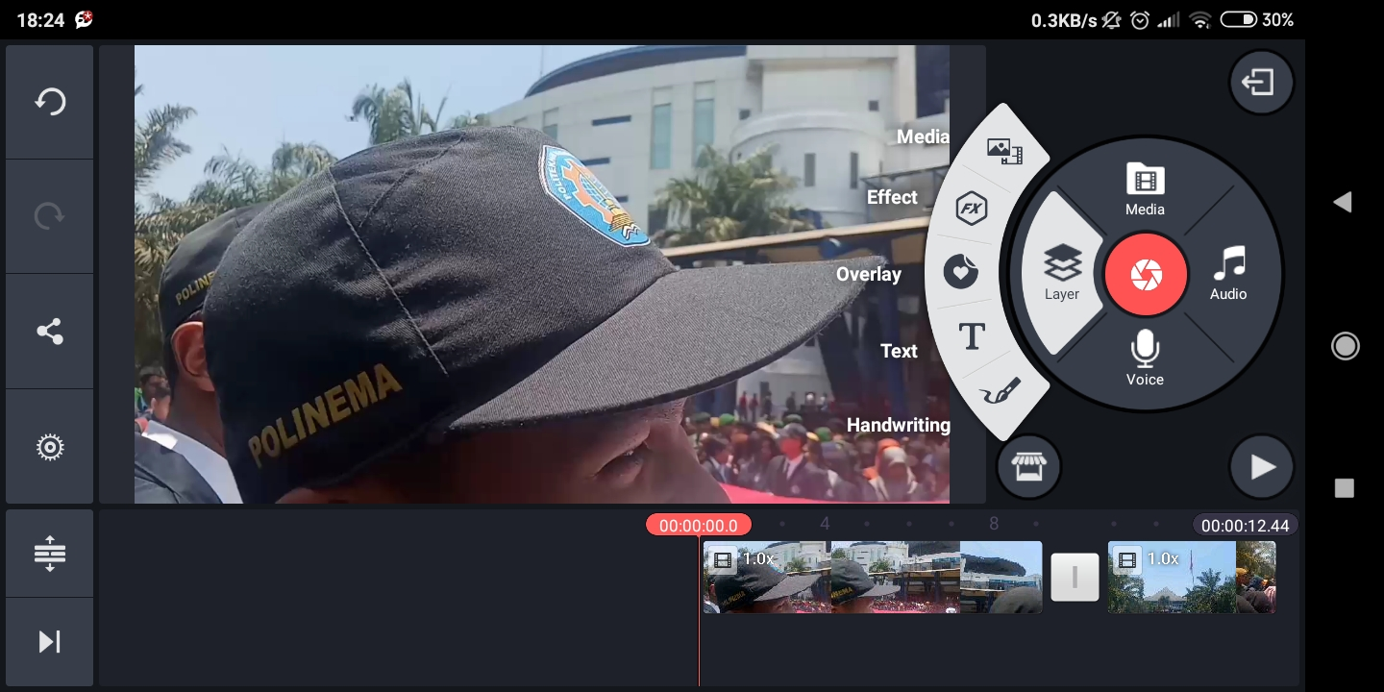
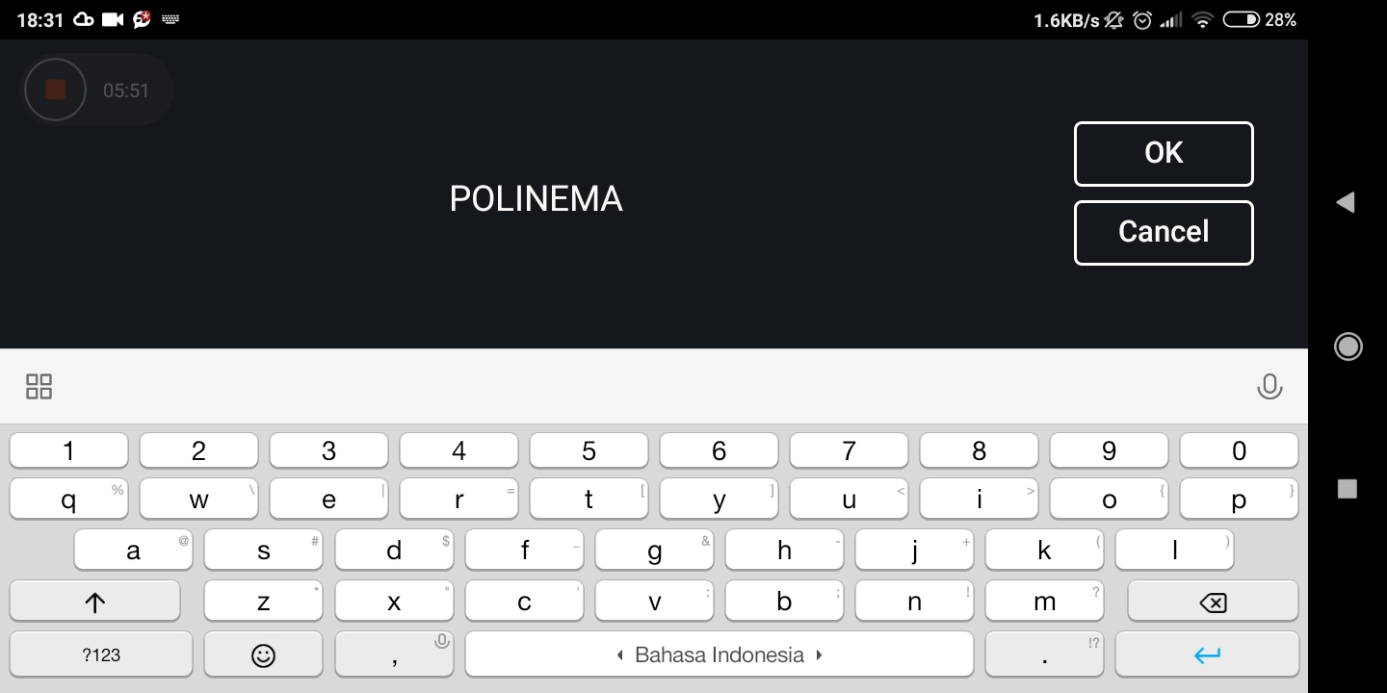
12. Next, add text on the video.

Slide 18
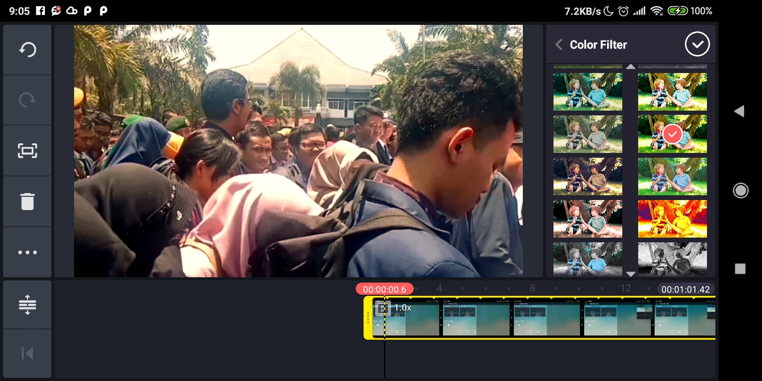
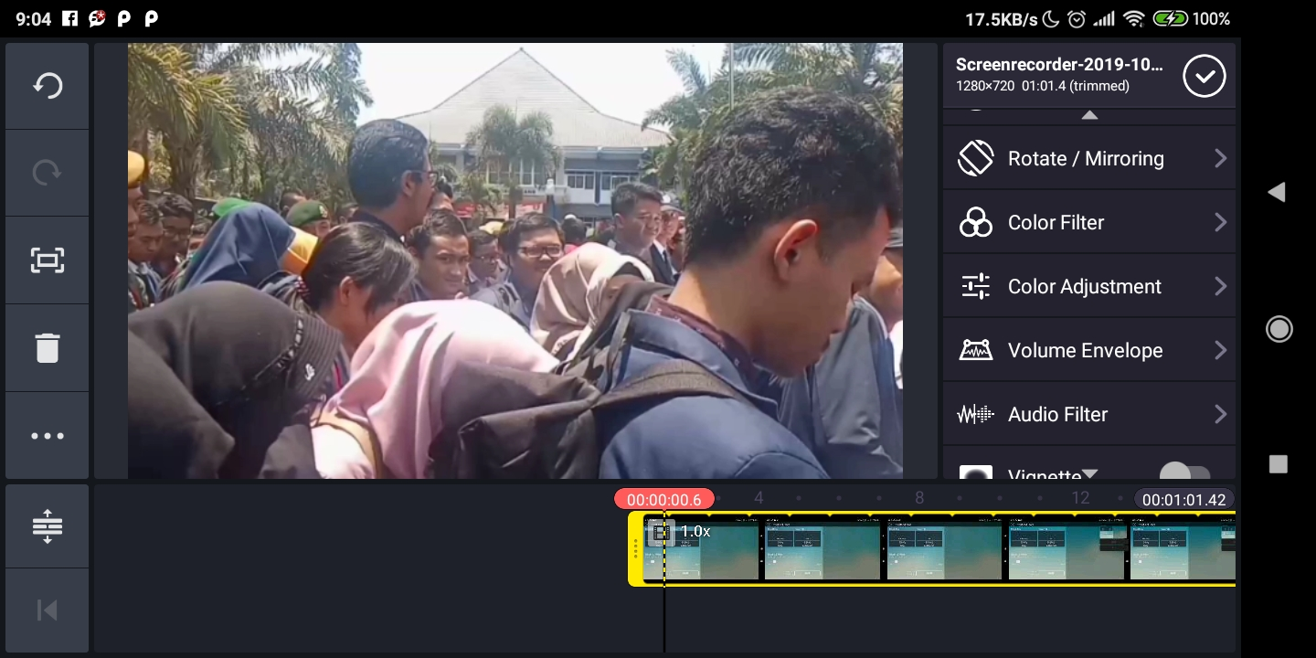
13. Next, select filter the video .

Slide 19
14. Editing is finished.

Slide 20
15. After edit video, export video to gallery.

Slide 21
Thank You

